Slide 1
DBMS SQL-DML

Slide 2
DML
DML stands for Data Manipulation Language.
It is a language used for selecting, inserting, deleting and updating data in a database.
It is used to retrieve and manipulate data in a relational database.

Slide 3
DML commands
1. SELECT
2. INSERT
3. UPDATE
4. DELETE

Slide 4
SELECT COMMAND
SELECT command is used to retrieve data from the database.
This command allows database users to retrieve the specific information they desire from an operational database.
It returns a result set of records from one or more tables.

Slide 5
optional clauses
Clause | Description
WHERE | It specifies which rows to retrieve.
GROUP BY | It is used to arrange the data into groups.
HAVING | It selects among the groups defined by the GROUP BY clause.
ORDER BY | It specifies an order in which to return the rows.
AS | It provides an alias which can be used to temporarily rename tables or columns.

Slide 6
Syntax: SELECT * FROM <table_name>;
SELECT * from <table_name>
where condition

Slide 7
Example : SELECT Command
SELECT * FROM employee; OR SELECT * FROM employee where salary >=10,000;

Slide 8
SELECT * FROM employee;
E_id | E_name | E_salary
001 | Rohan | 12,000
002 | Sohan | 11,000
003 | Mohan | 9,500

Slide 9
SELECT * FROM employee where salary >=10,000;
E_id | E_name | E_salary
001 | Rohan | 12,000
002 | Sohan | 11,000

Slide 10
INSERT COMMAND
INSERT command is used for inserting a data into a table.
Using this command, you can add one or more records to any single table in a database.
It is also used to add records to an existing code.

Slide 11
Syntax:
INSERT INTO <table_name> VALUES (`value1`, `value2`, . . . , `value n`);

Slide 12
Example:
E_id | E_name | E_salary
001 | Rohan | 12,000
002 | Sohan | 11,000
003 | Mohan | 9,5000
INSERT INTO employee VALUES (004, `Arohan`, 11,500);
E_id | E_name | E_salary
001 | Rohan | 12,000
002 | Sohan | 11,000
003 | Mohan | 9,5000
004 | Arohan | 11,500

Slide 13
UPDATE COMMAND
UPDATE command is used to modify the records present in existing table.
This command updates existing data within a table.
It changes the data of one or more records in a table.

Slide 14
Syntax:
UPDATE <table_name> SET <column_name = value> WHERE condition;

Slide 15
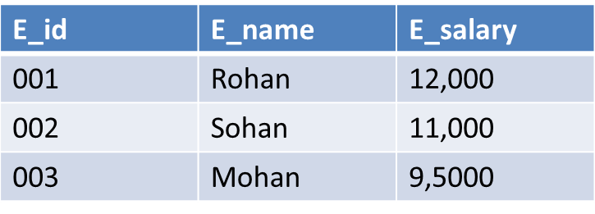
Example
UPDATE employee SET E_salary=20000 WHERE E_name=‘Rohan';
E_id | E_name | E_salary
001 | Rohan | 20,000
002 | Sohan | 11,000
003 | Mohan | 9,5000

Slide 16
DELETE COMMAND
DELETE command is used to delete some or all records from the existing table.
It deletes all the records from a table.

Slide 17
Syntax:
DELETE FROM <table_name> WHERE <condition>;

Slide 18

Example
DELETE FROM employee WHERE e_id = '001';
E_id | E_name | E_salary
002 | Sohan | 11,000
003 | Mohan | 9,5000

Slide 19
If we does not write the WHERE condition, then all rows will get deleted.
DELETE from employee;
E_id | E_name | E_salary

Slide 20
Thank you !

